Slide 1
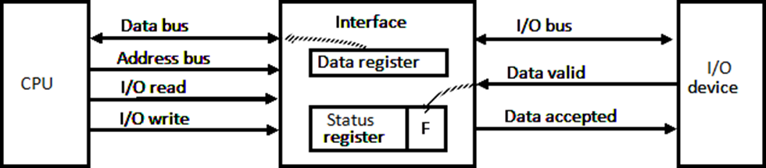
Modes of Data Transfer
Mode of Transfer:- Binary information received from an external device is usually stored in memory for later processing.
Data transfer to and from peripherals may be handled in one of three possible modes:
1. Programmed I/O
2. Interrupt-initiated I/O
3. Direct memory access (DMA)
Programmed I/O:

Slide 2
In the programmed I/O method, the I/O device does not have direct access to memory.
An example of data transfer from an I/O device through an interface into the CPU is shown in figure.
When a byte of data is available, the device places it in the I/O bus and enables its data valid line.
The interface accepts the byte into its data register and enables the data accepted line.
The interface sets a bit in the status register that we will refer to as an F or "flag" bit.
The device can now disables the data valid line, but it will not transfer another byte until the data accepted line is disables by the interface.
A program is written for the computer to check the flag in the status register to determine if a byte has been placed in the data register by the I/O device.
This is done by reading the status register into a CPU register and checking the value of the flag bit.
Once the flag is cleared, the interface disables the data accepted line and the device can then transfer the next data byte.

Slide 3
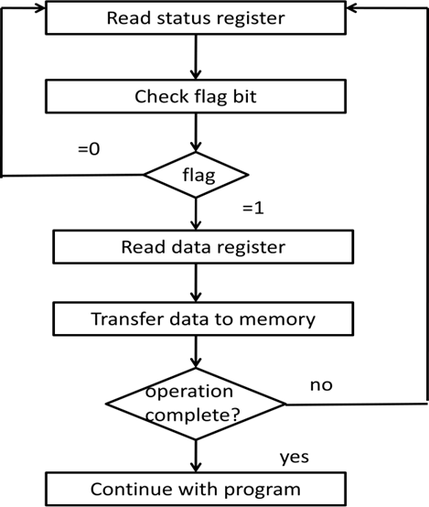
Example of Programmed I/O:
A flowchart of the program that must be written for the CPU is shown as follow

Slide 4
It is assumed that the device is sending a sequence of bytes that must be stored in memory.
The transfer of each byte requires three instructions:
1.Read the status register.
2.Check the status of the flag bit and branch to step 1 if not set or to step 3 if set.
3.Read the data register.
Each byte is read into a CPU register and then transferred to memory with a store instruction.
A common I/O programming task is to transfer a block of words from an I/O device and store them in a memory buffer.

Slide 5
Interrupt Initiated I/O
In programmed initiated, CPU stays in a program loop until the I/O unit indicates that it is ready for data transfer.
This is a time consuming process since it keeps the processor busy needlessly.
It can be avoided by using an interrupt facility and a special command to inform the interface to issue an interrupt request signal when data are available from the device.
In the meantime CPU can proceed to execute another program.
The interface meanwhile keeps monitoring the device.
When the interface determines that the device is ready for data transfer, it generates an interrupt request to the computer.
While the CPU is running a program, it does not check the flag. However, when the flag is set, the computer is momentarily interrupted from proceessing with the current program and is informed of the fact that the flag has been set.
The CPU move from what it is doing to take care of the input or output transfer.
After the transfer is completed, the computer returns to the previous program to continue what it was doing before the interrupt.
The CPU responds to the interrupt signal by storing the return address from the program counter into a memory stack and then control branches to a service routine that processes the required I/O transfer.

Slide 6
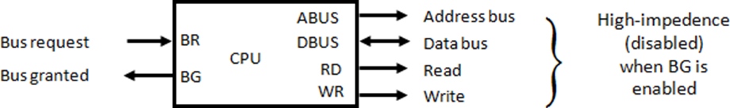
Direct Memory Access (DMA)
The transfer of data between a fast storage device such as magnetic disk and memory is often limited by the speed of the CPU. Removing the CPU from the path and letting the peripheral device manage the memory buses directly would improve the speed of transfer. This transfer techniques is called Direct Memory Access (DMA). During DMA transfer the CPU is idle and has no control of the memory buses.

Slide 7
Bus Request:- The bus request input is used by the DMA controller to request the CPU to relinquish control of the buses. When the input is active, the CPU terminates the execution of the current instruction and place the address, data bus, read and write lines into high impedance state. The high impedance state behaves like an open circuit, which means that the output is disconnected and does not have a logic significance.
Bus Grant:- The CPU activates the Bus grant (BG) output to inform the external DMA that the buses are in the high -impedance state. The DMA that originated the bus request can now take control of the buses to conduct memory transfers without processor intervention. When the DMA terminates the transfer, it disables the bus request line. The CPU disables the bus grant, takes control of the buses, and returns to its normal operation.
When the DMA takes control of the bus system, it communicates directly with the memory. The transfer can be made in several ways.

Slide 8
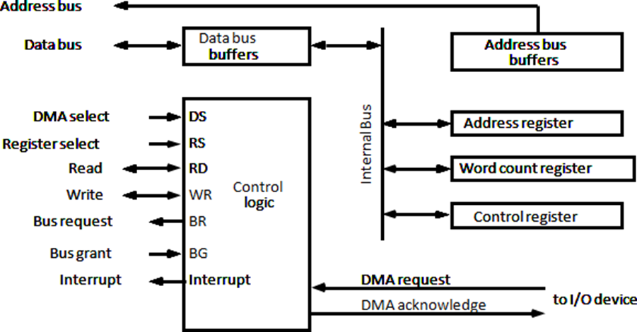
DMA Controller

Slide 9
The DMA controller has three registers: an address register, a word count register, and a control register.
The Address Register contains an address to specify the desired location in memory. The address bits go through bus buffers into the address bus. The address register is incremented after each word that is transferred to memory.
The Word Count Register specifies the number of words that must be transferred. The word count register is incremented after each word that is transferred to memory. The word count register holds the number of words to be transferred. This register is decremented by one after each word transfer and internally tested for zero.
The Control Register specifies the mode of transfer. All registers in the DMA appear to the CPU as I/O interface registers. Thus the CPU can read from or write into the DMA registers under program control via the data bus.
The data transfer may be done directly between the device and memory under control of the DMA.
The unit communicates with the CPU via the data bus and control lines.
The registers in the DMA are selected by the CPU through the address bus by enabling the DS (DMA select) and RS (register select) inputs.
The RD (read) and WR (write) inputs are bidirectional.

Slide 10
When the BG (bus grant) input is 0, the CPU can communicate with the DMA registers through the data bus to read from or write to the DMA registers.
When BG = 1, the CPU has relinquished the buses and the DMA can communicate directly with the memory by specifying an address in the address bus and activating the RD or WR control.
The DMA communicates with the external peripheral through the request and acknowledge lines by using a prescribed handshaking procedure.

Slide 11
DMA Transfer

Slide 12
The position of the DMA controller among the other components in a computer system is illustrated in the Figure.
The CPU communicates with the DMA through the address and data buses as with any interface unit.
The DMA has its own address, which activates the DS and RS lines.
The CPU initializes the DMA through the data bus. Once the DMA receives the start control command, it can start the transfer between the peripheral device and the memory.
When the peripheral device sends a DMA request, the DMA controller activates the BR line, informing the CPU to relinquish the buses.
The CPU responds with its BG line, informing the DMA that its buses are disabled. The DMA then puts the current value of its address register into the address bus, initiates the RD or WR signal, and sends a DMA acknowledge to the peripheral device.
Note that the RD and WR lines in the DMA controller are bidirectional. The direction of transfer depends on the status of the BG line.
When BG line. When BG = 0, the RD and WR are input lines allowing the CPU to communicate with the internal DMA registers.
When BG = 1, the RD and WR and output lines from the DMA controller to the random access memory to specify the read or write operation for the data.

Slide 13
When the peripheral device receives a DMA acknowledge, it puts a word in the data bus (for write) or receives a word from the data bus (for read).
Thus the DMA controls the read or write operations and supplies the address for the memory. The peripheral unit can then communicate with memory through the data bus for direct transfer between the two units while the CPU is momentarily disabled.
For each word that is transferred, the DMA increments its address registers and decrements its word count register.
If the word count register reaches zero, the DMA stops any further transfer and removes its bus request. It also informs the CPU of the termination by means of an interrupt.
When the CPU responds to the interrupt, it reads the content of the word count register. The zero value of this register indicates that all the words were transferred successfully.

